Slide 1
CS501 Mini Research
Hsueh-Yuan Chou, Haowei Li, Daniel Kim, Zack Wang, Lianghao Wu, David Yan

Slide 2

LetsEat
LetsEat app is designed for lonely BU students to dine out with other BU students.
We will match users based on their majors and preference to types of cuisine. Users will choose to match or unmatch other users (swipe left or right) just like tinder.
After matched, users are able to chat with each other.
Users are able to chat with others after they match and the app will suggest restaurants for them to dine. Also users can search the restaurants they want.

Slide 3
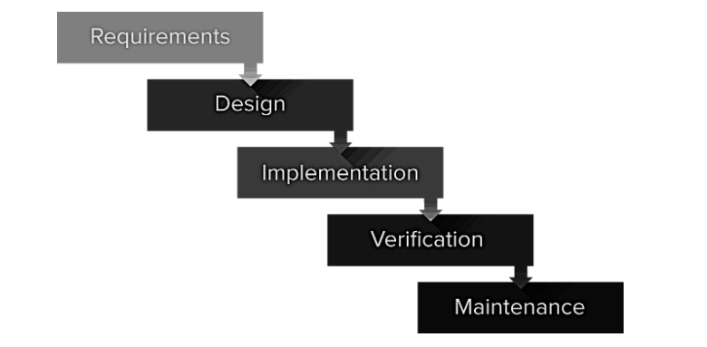
Software Development Life Cycle

Slide 4



APIs
Yelp
SendBird
Twitter

Slide 5
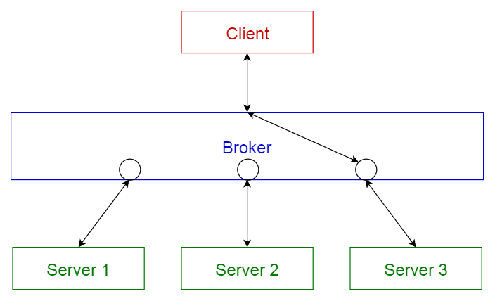
Architecture
Broker pattern

Slide 6
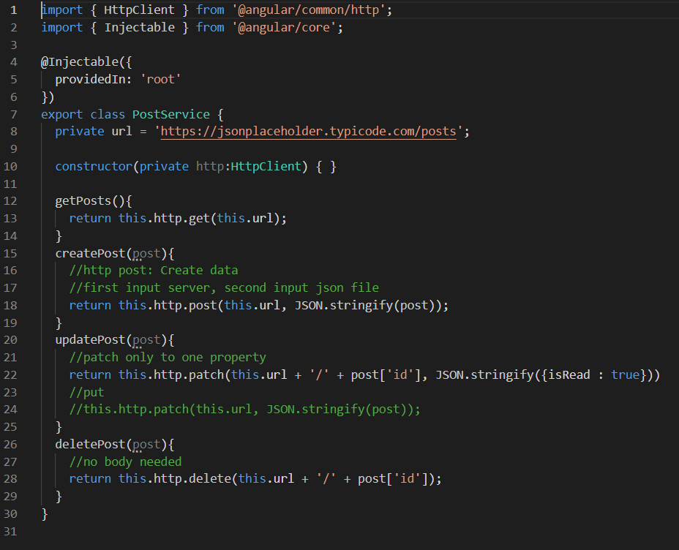
Example of Broker Pattern

Slide 7
Why Yelp
Why we use Yelp API?
We use yelp to provide user restaurants search
Yelp is open, friendly resource for api.
We will suggest restaurants for users depend on their preference.
User can check restaurants rating and reviews from yelp.

Slide 8
API Overview
Two available APIs on yelp: Fusion and GraphQL
We use Yelp Fusion
Data is placed with categories (endpoints)
These endpoints make it easier to get a bulk of data from one or two requests

Slide 9
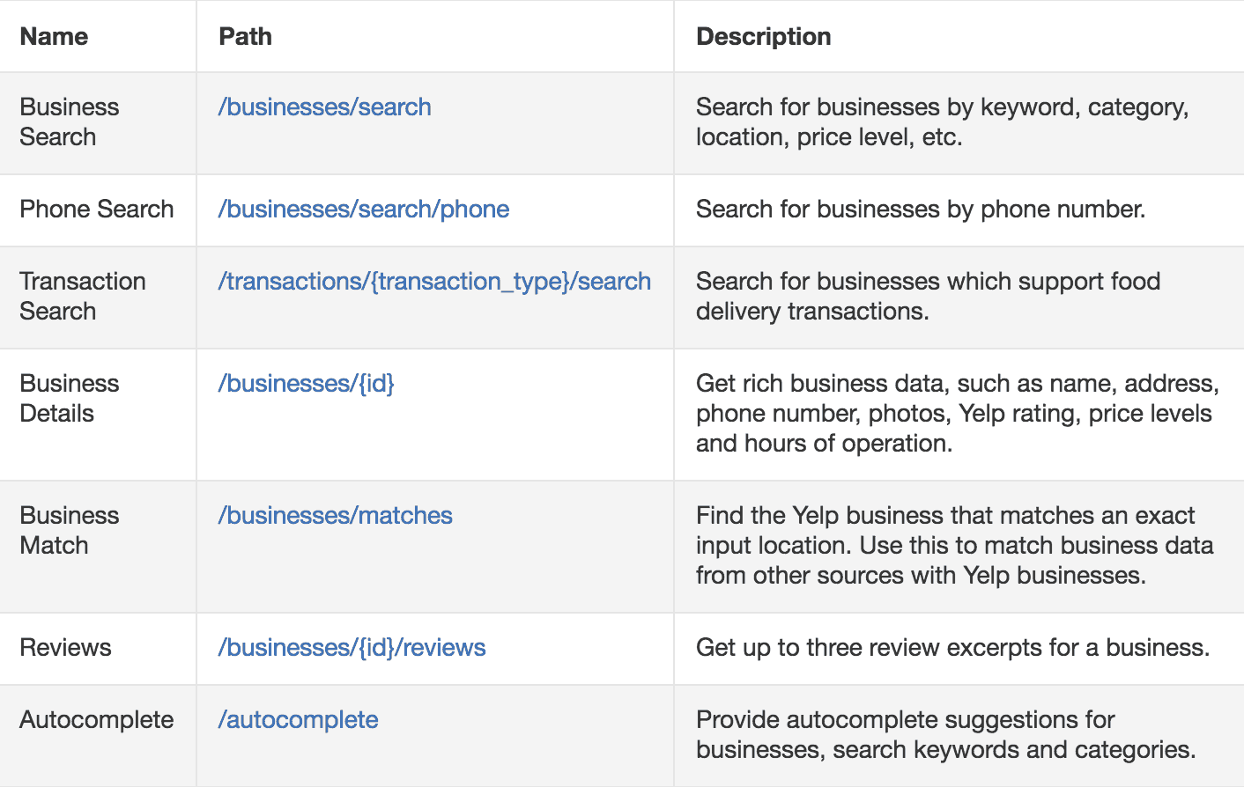
Fusion Endpoints

Slide 10
Yelp API Walk Through
https://docs.google.com/document/d/1ErfH_eBCSSER-ZVKnnuJd-lap5Gxz3mT7zRVmO2Je4k/edit?usp=sharing

Slide 11
APP Demo

Slide 12
SendBird Chat API Overview
SendBird Chat is an API that helps developers to build modern chat and messaging experience in applications.
On the client-side implementation, SendBird provides classes and methods to initialize the chat, and connects to the server .
On the server-side, SendBird takes care of everything and ensures reliable services for chat within our application.
SendBird also provides prebuilt UI components that allow us to craft a chat application interface with all the essential features.

Slide 13
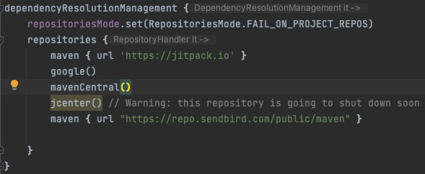
Implementation: User Interface
Install SendBird UIkit:
Inside “setting.gradle” file:
Software rarely works in isolation. Projects tend to rely on reusable functionality in the form of library.
Gradle can retrieve dependencies from one or many repositories. We define all the repositories inside the dependencyResolutionManagement.

Slide 14



Implementation: User Interface
Install SendBird UIkit:
Inside “build.gradle” file:
Without databinding:
With databinding:
The Data Binding Library is a support library that allows you to bind UI components in your layouts to data sources using a declarative format rather than programmatically.

Slide 15
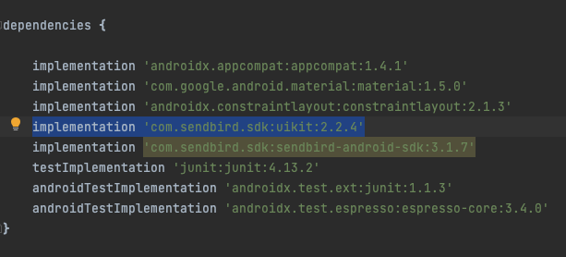
Implementation: User Interface
Install SendBird UIkit:
Inside “build.gradle” file:
Adding the uikit dependency by this line of code

Slide 16
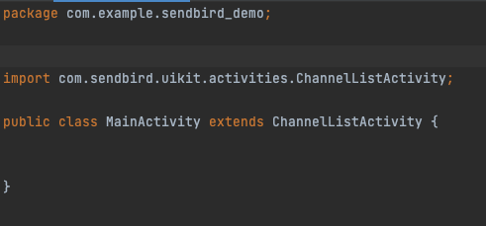
Implementation: User Interface
Install SendBird UIkit:
Inside MainActivity:
Let the MainActivity inherits from the ChannelListActivity imported from the UIkit dependency. The application would have a chat application interface after the implementation.

Slide 17
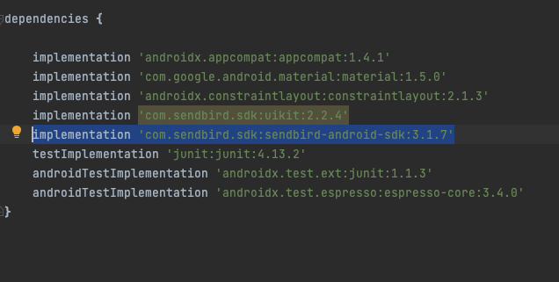
Implementation: Base Application
Inside “build.gradle” file:
Implement the sendbird-android-sdk.

Slide 18
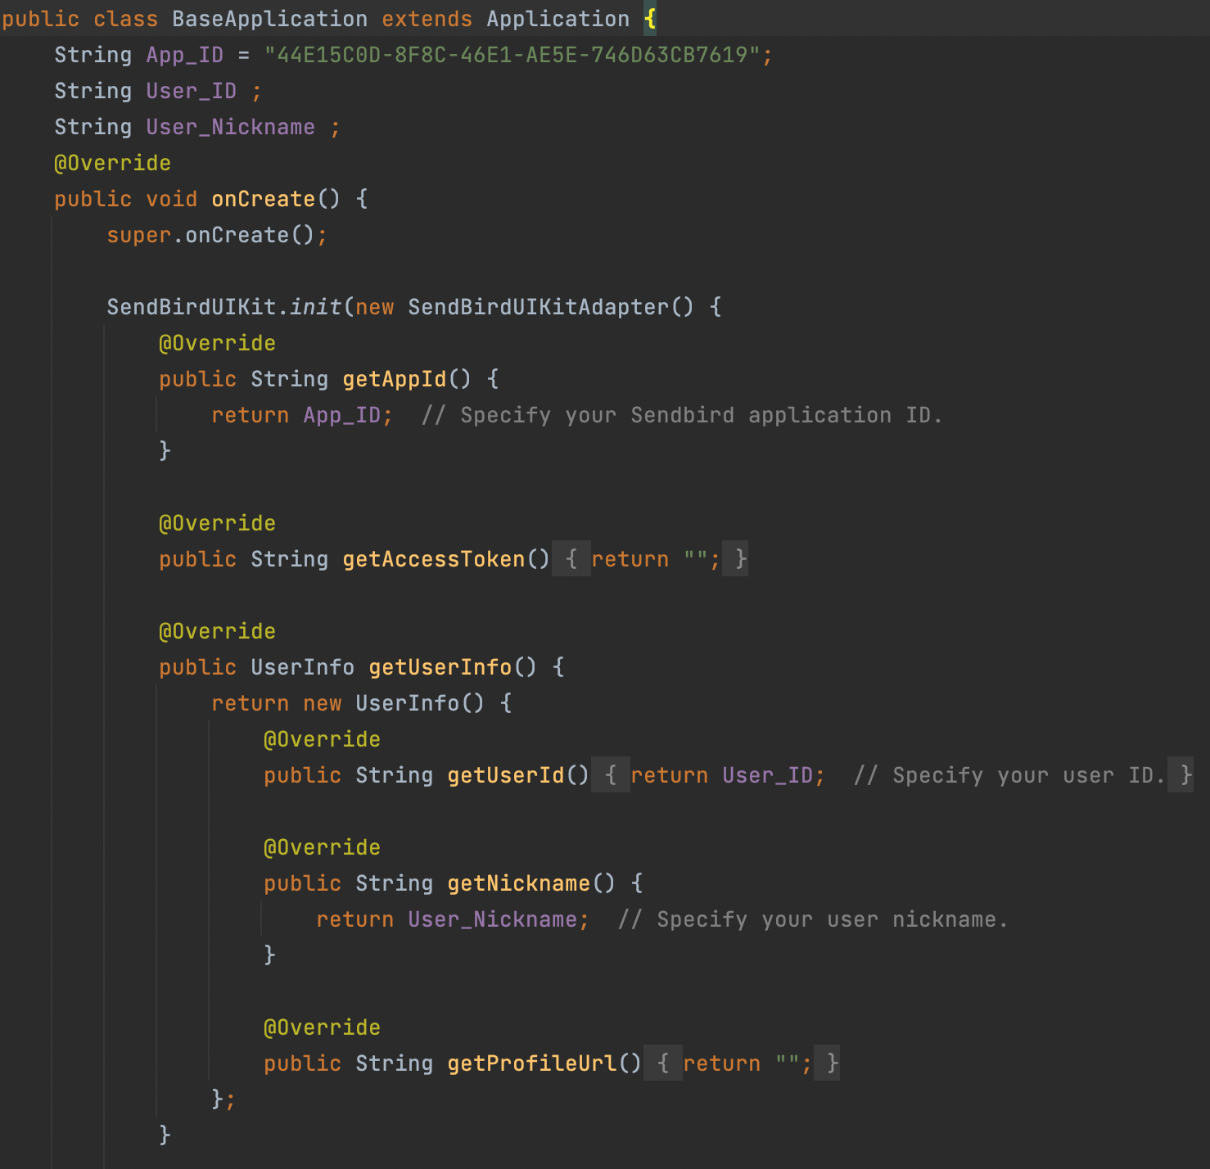
Implementation: Base Application
To integrate and run Sendbird UIKit with user information in our application, we need to initialize an UIkit instance first.
We can initialize the instance by passing the sendBirdUIKitAdapter instance as an argument to a parameter in the SendBirdUIKit.init() method.

Slide 19
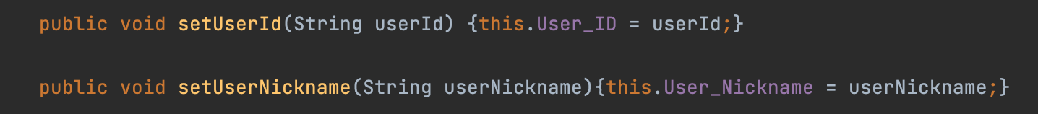
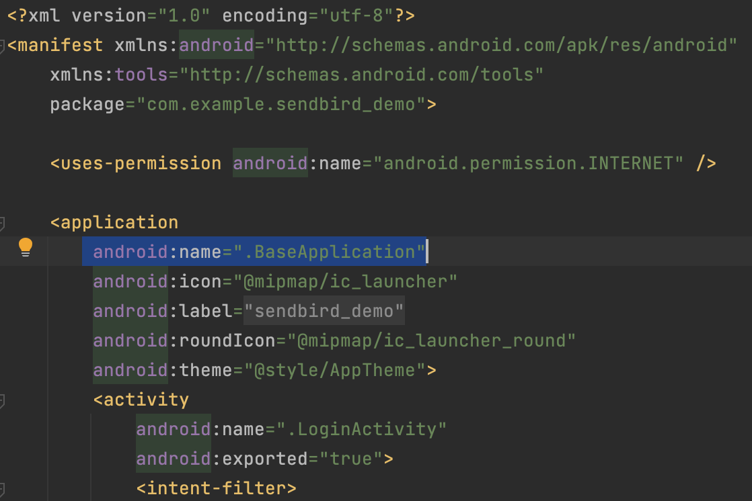
Implementation: Base Application
Setter methods inside the BaseApplication class that will be be called in the loginActivity.
Inside the AndroidManifest.xml, add the created BaseApplication to the name attribute under application tag.
This will make sure when the application process is started, BaseApplication is instantiated before any application’s component.

Slide 20
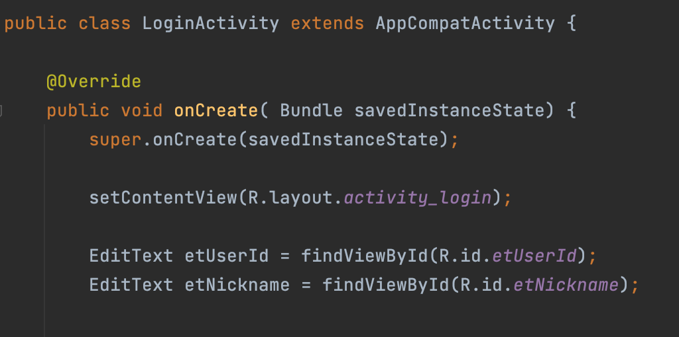
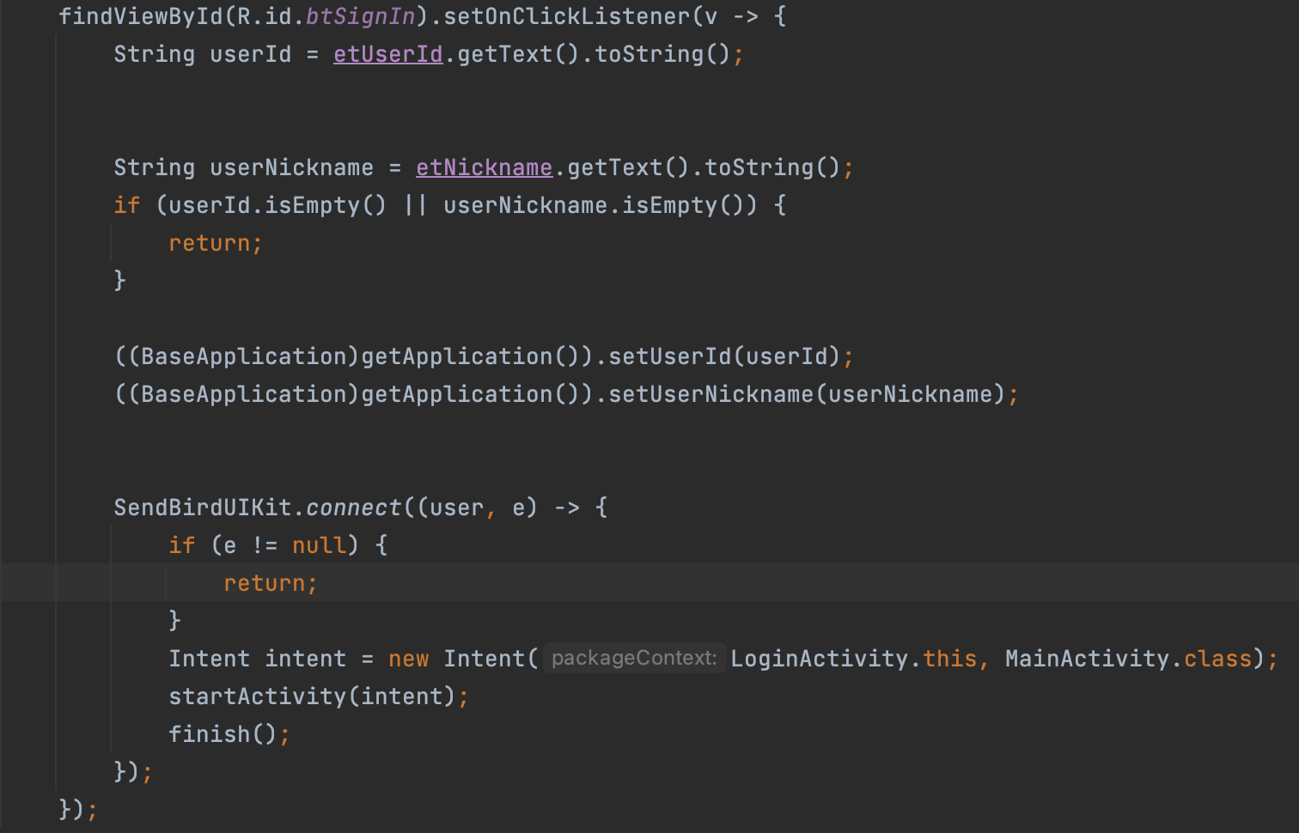
Implementation: Login Activity Implementation
Basic stuff: Finding views
Set an onClickListener to the login button.
Will call the setter methods in the baseApplication class to set user’s credentials ,kind of like fragment communication.
SendBirdUIKit.connect will establish connection to SendBird server with the information provided in the SendBirdUIKitAdapter in the baseApplication class.
If a connection is successfully built, the app will move to the mainAcitivity where the chat interface is implemented

Slide 21
App Demo

Slide 22
Twitter API Overview
Why are we using Twitter API?
One of the core concepts of our app is “MATCH”. We are going to match users with similar interests, or match users with common topics. Twitter is a platform where users can share their lives and interests. It perfectly matches our requirements.
To better match users, we need plenty of datas. Twitter is a very popular social media platform, it has a large amount of users. It’s convenient for us to match users through this platform.

Slide 23
API reference index
Users lookup
GET /2/users/:id
GET /2/users/by/username/:username
GET /2/users/me
Follows
GET /2/users/:id/followers
GET /2/users/:id/following
List follows
GET /2/lists/:id/followers
GET /2/users/:id/followed_lists
Likes
GET /2/tweets/:id/liking_users
GET /2/users/:id/liked_tweets

Slide 24
Volley
A networking library managed by the RequestQueue and mainly used for smaller Networking purposes in Android.

Slide 25
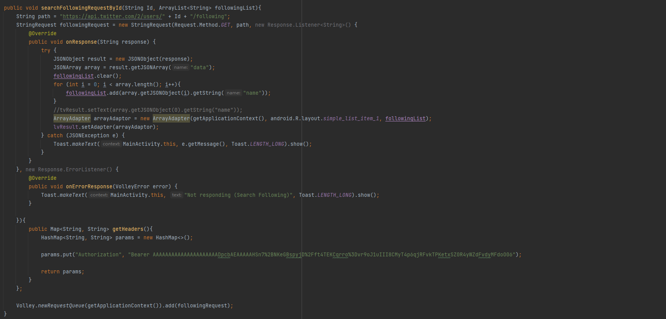
Example request

Slide 26
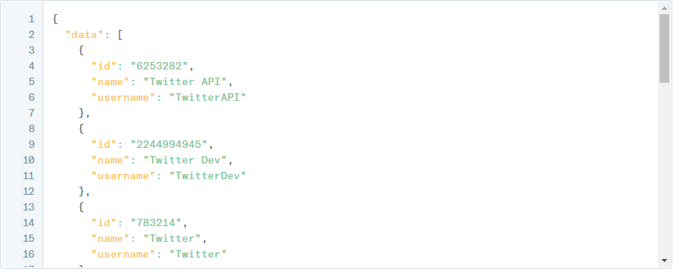
Example response

Slide 27
App Demo

Slide 28
Q&A

Slide 29
Thank You

